Slide 1


EPE Distance Education Training
September 2021

Slide 2
Let’s begin by reviewing NYS EPE policy for Distance Education Programming
GRASP SMART ESL

Slide 3
New Policy on entrance criteria:
NRS Levels 4, 5, and 6
Teacher designs two week packets so students can learn independently at home
May or may not include online materials
Curricula and appropriate materials are determined by the program/teacher
Should include all subtest areas of the HSE exam
GRASP
Giving Ready Adults a Study Program

Slide 4
New Policy on entrance criteria:
  NRS Levels 2, 3, and 4
  Teacher designs two week packets so students can learn independently at home
  Math and Writing SMART curricula must be included
  Additional NRS Level appropriate materials are selected by the teacher
  Should include all subtest areas of the HSE exam
SMART
Skills to Make Adults Ready To Succeed

Slide 5
GRASP & SMART
Materials are at the discretion of the program and distance education teacher, must be of NRS Level appropriateness
Online resources and lessons may be provided to students however we encourage that none will have a cost to the students
Instructional software may be used as assignments should the adult literacy program have availability

Slide 6
GRASP & SMART
All 5 Subtest areas of the HSE exam should be included in the materials provided to students for independent learning:
    Reading (English Language Arts)
    Writing
    Social Studies
    Math
    Science

Slide 7
New Policy on entrance criteria:
NRS Levels 3, 4, 5, and 6
Teacher designs two week packets so students can learn independently at home
May or may not include online materials
Curricula and appropriate materials are determined by the program/teacher
ESL Distance Education
For ESL Students

Slide 8
ESL Distance Education
Materials are at the discretion of the program and distance education teacher
Must be of NRS Level appropriateness
Online resources and lessons may be provided to students however we encourage that none will have a cost to the students
Instructional software may be used as assignments should the adult literacy program have availability and they are geared toward ESL learners

Slide 9
In all 3 EPE Distance Education Programs
Distance Education is provided through a two week packet program
Teacher/program determines the curricula being used
Students get a packet with two weeks’ worth of academic work, they take it home, work on it when they can... and return the packet when they are finished
When they finish a packet and return it for correcting, there is another packet waiting for them to take home for the next two weeks

Slide 10
Student Eligibility:
At least 21 years of age or older
Does not have a US High School Diploma
Standard EPE eligibility
as with any traditional EPE programming

Slide 11
Student Eligibility:
Up to 3% of a programs’ accrual may be for services for adult students 21 years of age and older who do have a HS Diploma or its’ equivalent but have low literacy skills
This is a local program decision
Standard EPE eligibility
as with any traditional EPE programming

Slide 12
Student Eligibility:
Students must reside within the service delivery area for their BOCES or school district, there are no exceptions
EPE programs may apply for a geographic waiver, this is done on the District Superintendent or Superintendent level, not on a program level

Slide 13
Intake, Orientation, and Assessment
For EPE funded programs approved to provide Distance Education packet programming

Slide 14
Intake
Individual Student Record Form (ISRF)
  New form must be completed every new fiscal year
  Student must sign the ISRF annually indicating they are aware of the Employment Follow Up requirements
Barriers to Employment
  Critical information to federal reporting for NYS
    One of those barriers would lead them to distance education, not intended for every student

Slide 15

Intake
AEPP EPE Distance Education Screening Tool
    Must be signed by the student and maintained in the student’s permanent folder

Slide 16
Intake
Conversation about goals from the student’s perspective
Attendance policy, expectations for distance education students
Begin developing the Education and Employment Plan (EEP) required under EPE guideline
American Disabilities release form, explain to students

Slide 17
Intake
Explain Fast Track options if the program is approved to provide:
    Fast Track GRASP Math Packets, 16 packets
    Six-hour intense instruction in one subtest area
    Two by Two subtest areas
    Test taking skills
    Computer based testing skills

Slide 18
Intake
Record all time spent during the intake process
  Can be individual or in group setting
  Recording all the time spent is important for two reasons: 1. the contact hours are reimbursable under EPE funding and 2. the contact hours indicate the time you spent supporting the students which is required under EPE funding
  You are required to provide this guidance to students
  No contact hours recorded infers the work was not done

Slide 19
Orientation
Student must commit to studying at home
Must sign AEPP EPE Distance Education Student Agreement
Must agree to Post-testing in person
HSE readiness testing in person when/if applicable
Being accountable for his/her own time

Slide 20
Student Agreement
Student Agreement is a fillable form
Must be signed by the student before recording the first packet

Slide 21
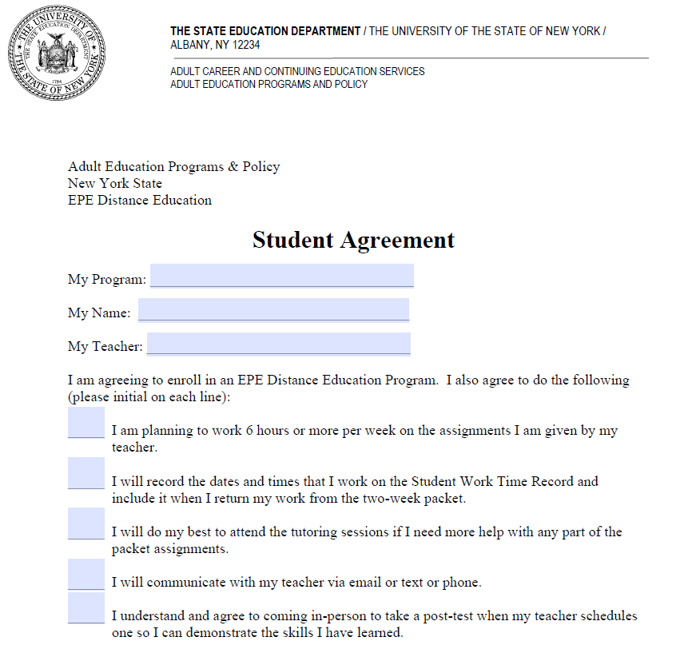
Student Agreement

Slide 22
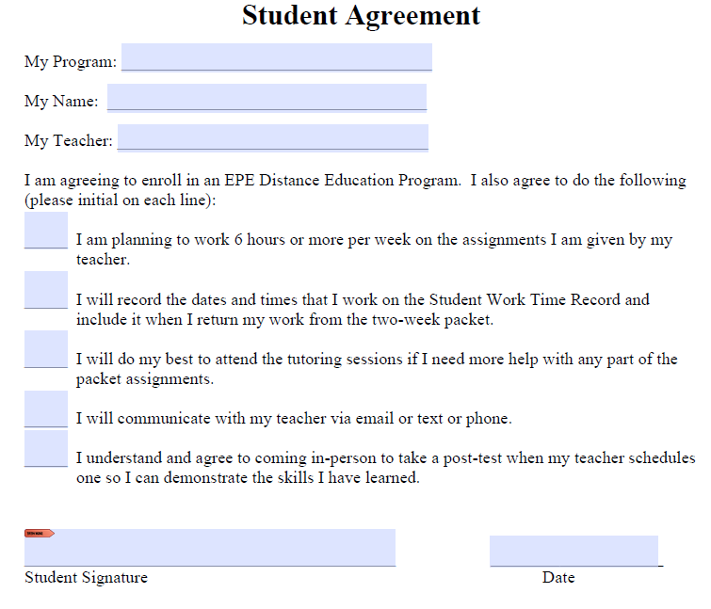
Student Agreement

Slide 23
Assessment
SMART or GRASP
ESL Distance Education
TABE 11/12 in both Math and Reading (the lower score determines the students’ NRS level)
BEST Plus 2.0
BEST Literacy 1.0

Slide 24
Assessment
SMART or GRASP
If a student has already passed the HSE Math Subtest, they may not TABE test in Math
The program will decide if a student in this position is tested in Math

Slide 25
Construction of the
Two Week Packets
Responsibility of the
Distance Education Teacher

Slide 26
Required Documents:
Packets may contain any combination of:
Math assignments
Science assignments
Social Studies materials and assignments
ELA: Reading
ELA: Writing
Job Readiness Training materials
Study Skills Practice
Books, novels
Consumables, worksheets, workbooks, graphic organizers
Student Work Time Record
Student’s Packet Assignments

Slide 27
Reminder:
All assignments may be paper or electronic
If you are directing students to websites, be sure they are without cost to the student
If your program has purchased specific software, it may be used for student assignments, it is not required

Slide 28
Student Work
Time Record
Each Program, SMART, GRASP, or ESL
has a customized Student Work Time Record
Required in every two-week packet

Slide 29
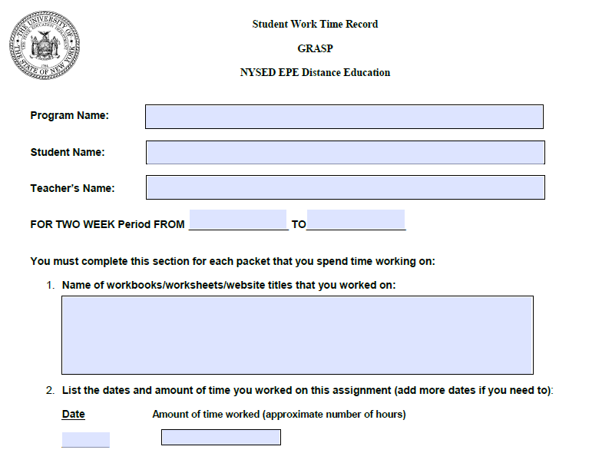
Student Work Time Record

Slide 30
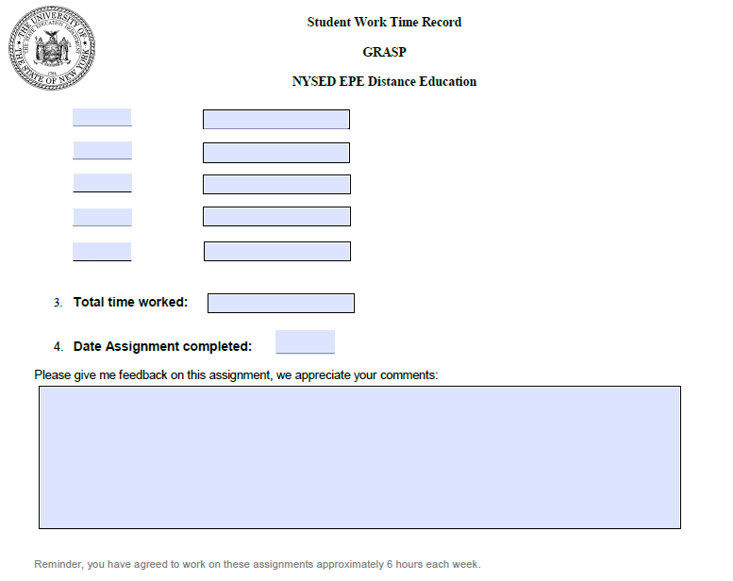
Student Work Time Record

Slide 31
Student
Packet Assignments
Each Program, SMART, GRASP, or ESL
has a customized Student Packet Assignments
Required in every two-week packet

Slide 32
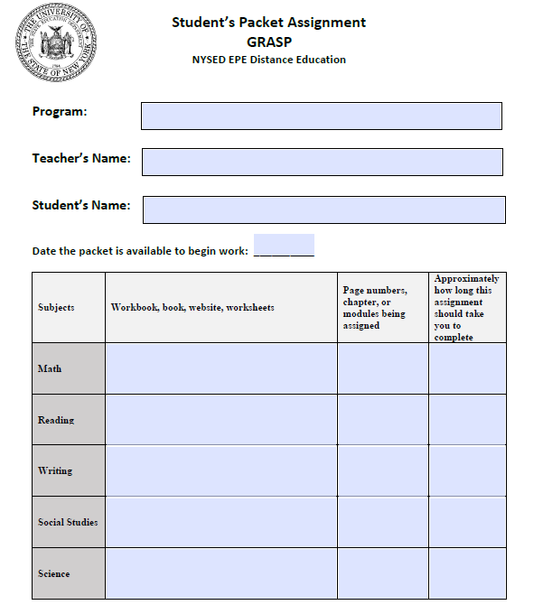
Student Packet Assignments

Slide 33
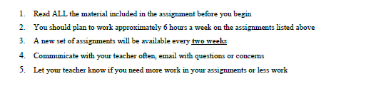
Student Packet Assignments

Slide 34
Teacher
Assignment Monthly Log
Each Program, SMART, GRASP, or ESL
has a customized Teacher Assignment Monthly Log
Required each month student is active in an EPE distance program

Slide 35
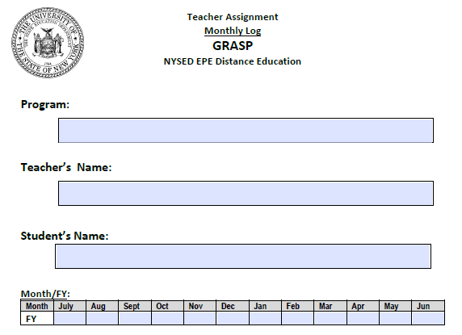
Teacher
Assignment Monthly Log

Slide 36
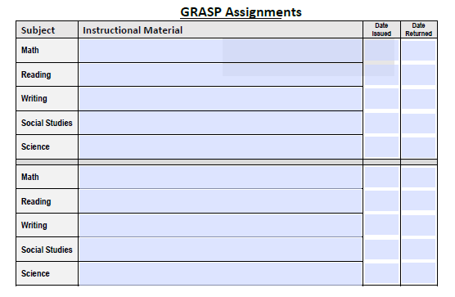
Teacher
Assignment Monthly Log

Slide 37
Packets can be:
Mailed (USPS) to the student along with a prepaid self-addressed envelope so the student can return their completed work
Electronic packet emailed to the student
Other web platforms supported by the program where students can access the two week packets
Make arrangements with local libraries or schools to serve as drop off/pick up locations for students to physically pick up and return completed packets

Slide 38
Packets can be:
At no time can packets be created generically, they are customized to the needs of the student and must be aligned with their assessment diagnostics

Slide 39
Instructor Responsibilities:
  Creating the new packet
  Correct and assess completed, returned packet along with congenial communication with student
  Maintain Teacher Assignment Monthly Log
  Update student files
  Arrange TABE post-testing when appropriate and HSE readiness testing when appropriate
Instructors have one hour per two-week packet to accomplish:

Slide 40
Instructor Responsibilities:
  Instructor formula for Program Managers:
  One half hour (1/2) per student per week (or one hour per packet per two week period)
  A teacher working 20 hours per week would be able to support 40 distance education students over a two week period
Instructor Formula

Slide 41
Motivation and Retention
Phone calls, letters, email, and text messages go a long way to keep students interested
Students want and need to
know you care!

Slide 42
Tutoring Expectations
Providing tutoring options to students is a mandatory element in EPE Distance Education programming

Slide 43
Providing tutoring options to students is a mandatory element in
EPE Distance Education programming
Distance Education students may choose to attend however the program is responsible for providing the opportunity

Slide 44
Tutoring
Each student may attend up to 3 hours of in-person tutoring for assistance
Maximum 12 contact hours per month
Tutoring classes are managed as any other traditional class in ASISTS
Each EPE Distance Education teacher must have a tutoring class assignment in ASISTS

Slide 45
Tutoring
OR a student may attend other traditional classes up to the same 3 hours of in-person assistance
Tutoring does not imply one-on-one instruction, the class may be a group setting or individual, program decides
Attendance in EPE Distance Education is recorded in real time and entered into ASISTS

Slide 46
Staff requirements:
Must also be EPE Distance Education certified (this training)
  EPE Distance Education certification is good for a 3 year period
  Every staff member in an EPE funded program must have a total of fourteen (14) hours of professional development per fiscal year from their RAEN center
Teachers must be Adult Education or K-12 certified through NYSED

Slide 47
Keeping Your EPE Distance Education Program NRS Compliant & Accountable
Reminder: No part of EPE Distance Education falls under Fast Track funding

Slide 48
Accountability Reminders:
Pre-test must be completed before the first packet is provided
Students must be pre-screened for distance education compatibility and capacity
The AEPP EPE Distance Education Screening Tool must be signed by the student and submitted to the student folder

Slide 49
Accountability Reminders:
Students cannot be co-enrolled in a traditional class and a distance education class concurrently (at the same time)
Students may only be enrolled in one distance education class and one traditional tutoring class concurrently (at the same time)

Slide 50
Accountability Reminders:
Attendance is only recorded when a two-week packet is completed and returned
Minimum time frame is a two week period, no sooner
Two packets may be returned and recorded in any given month
  Maximum 2 per month, no exceptions

Slide 51
Collecting and Recording Attendance in ASISTS

Slide 52

  1 packet returned = 12 contact hours (6 hours each week)
    Enter a “2” into ASISTS
  2 packets returned = 24 contact hours
    Enter a “4” into ASISTS
  The software will multiply the “2” or the “4” by 6 to credit the program the appropriate amount of contact hours
Attendance is recorded on a monthly basis

Slide 53
  Maximum per month is 2 packets, no exceptions
  Program does not get credited any amount of contact hours for reimbursement unless a packet is completed and returned
Attendance is recorded on a monthly basis

Slide 54
  Past accommodation of using “9999” code has been eliminated
  DO NOT RECORD 9999
  Programs must screen students adequately to assure the likelihood of students returning packet assignments

Slide 55
Creating EPE Distance Education Classes in ASISTS

Slide 56
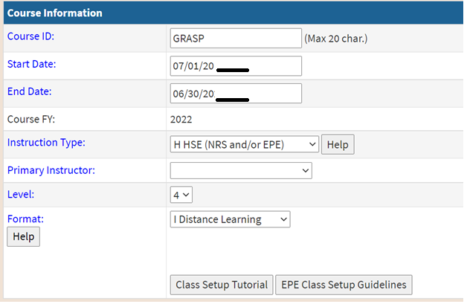
Every GRASP Distance Education teacher must have his/her own class code in ASISTS
GRASP classes must be categorized as HSE Instruction Type
Format must be Distance Learning

Slide 57
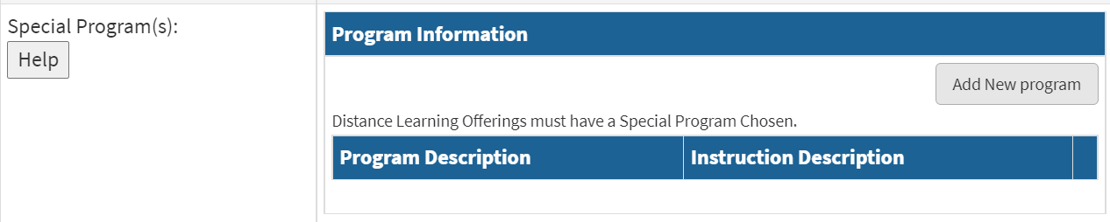
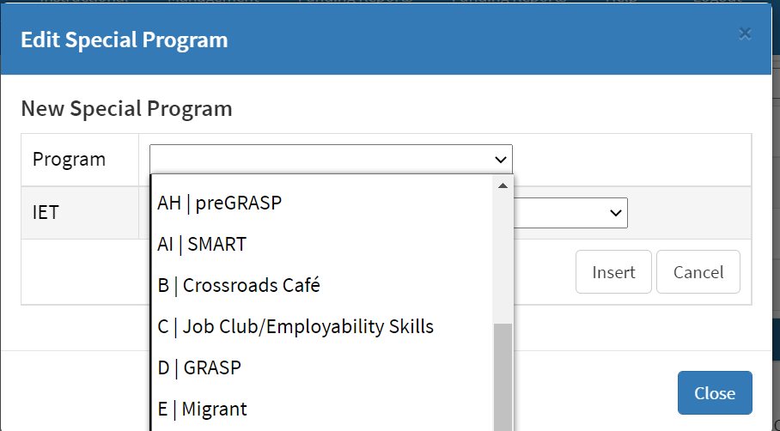
For every Distance Education class code in ASISTS the Special Program must be identified:

Slide 58
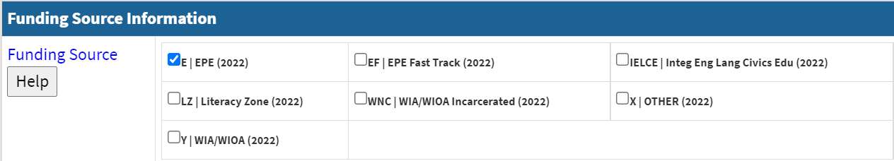
Every EPE Distance Education class must be funded as EPE
These classes CANNOT be combined with WIOA or EPE Fast Track

Slide 59
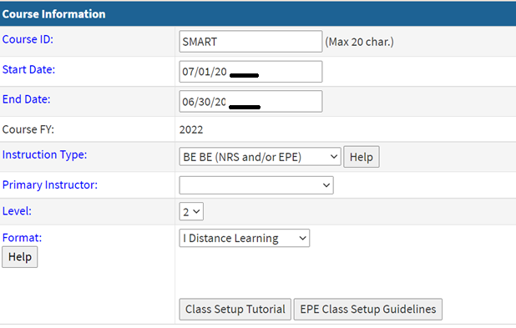
Every SMART Distance Education teacher must have his/her own class code in ASISTS
SMART classes must be categorized as BE Instruction Type
Format must be Distance Learning

Slide 60
For every Distance Education class code in ASISTS the Special Program must be identified:

Slide 61
Every EPE Distance Education class must be funded as EPE
These classes CANNOT be combined with WIOA or EPE Fast Track

Slide 62
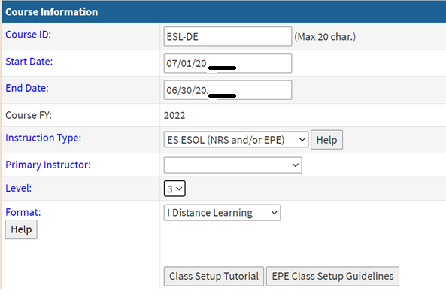
Every ESL Distance Education teacher must have his/her own class code in ASISTS
ESL DE classes must be categorized as ES Instruction Type
Format must be Distance Learning

Slide 63
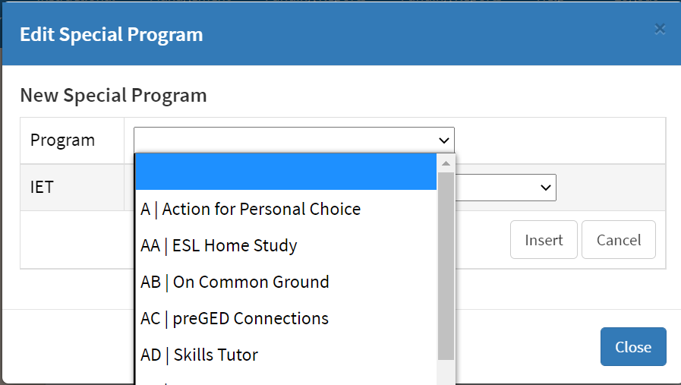
For every Distance Education class code in ASISTS the Special Program must be identified:

Slide 64
Every EPE Distance Education class must be funded as EPE
These classes CANNOT be combined with WIOA or EPE Fast Track

Slide 65
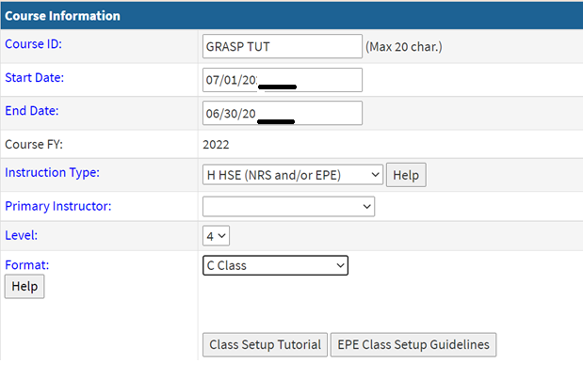
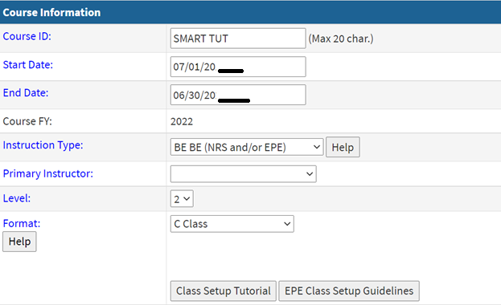
Setting Up Tutoring Classes:

Slide 66
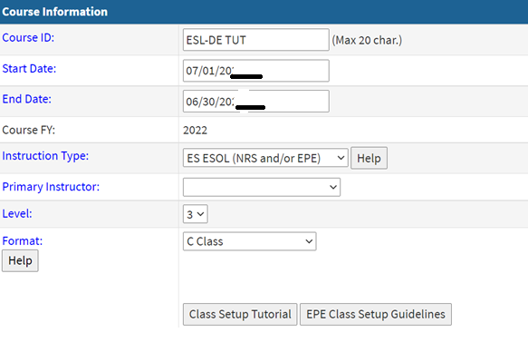
Setting Up Tutoring Classes:

Slide 67
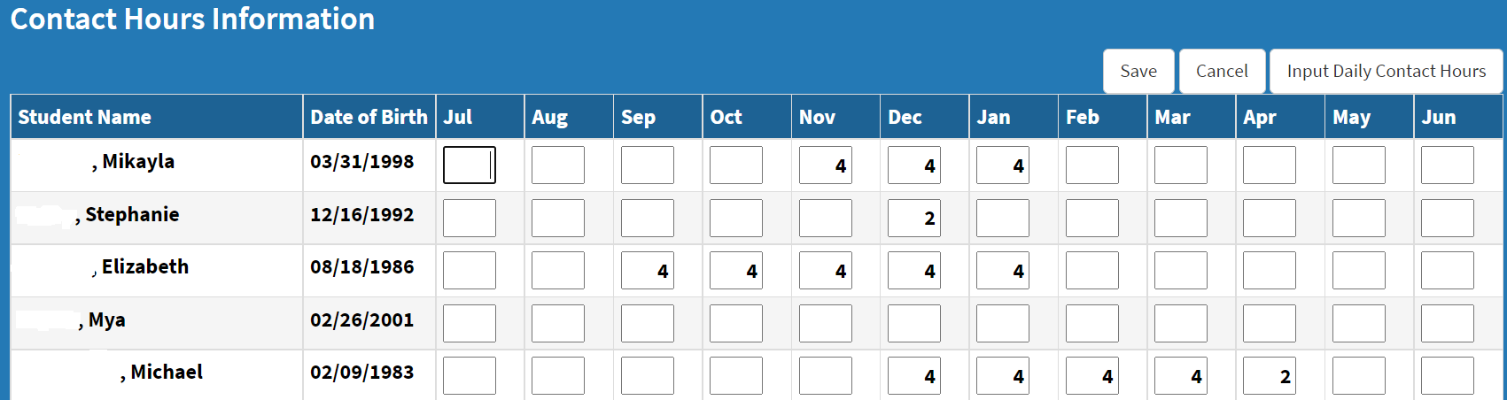
Sample Attendance
SMART or GRASP or ESL Distance Education Attendance

Slide 68
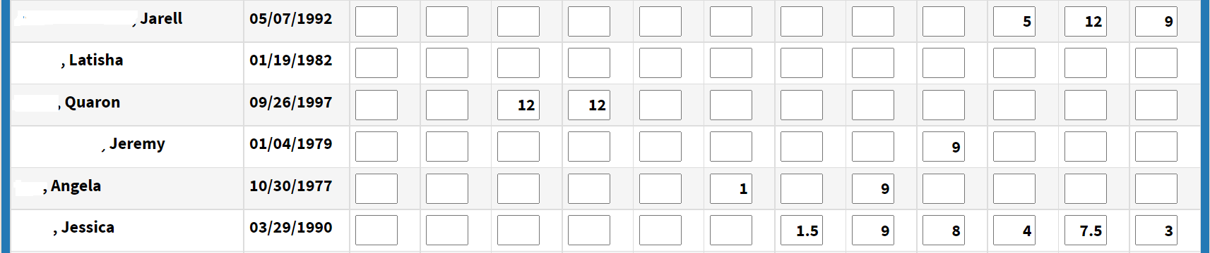
Sample Attendance
SMART or GRASP or ESL Traditional Tutoring Attendance

Slide 69

QUESTIONS?

